Slide 1
IOT PRESENTATION TOPIC: HAND GESTURE MOVING CAR
BY
SANJAI.S(210701230)
SHOBAN KUMARESAN(210701245)

Slide 2
INTRODUCTION
Hand Gesture Moving Car in IoT revolutionizes driving by allowing users to control vehicles with gestures. This innovative technology utilizes IoT to seamlessly integrate human-machine interaction, enhancing safety and convenience. With a simple wave or gesture, drivers can effortlessly navigate their cars, making driving more intuitive and responsive.
By simply gesturing with their hands, users can command the car to move forward, backward, turn left, or turn right, providing an intuitive and interactive way to operate the vehicle. This technology offers numerous advantages, including ease of use, hands-free operation, and enhanced accessibility for individuals with disabilities.
The implementation of hand gesture control in IoT remote cars opens up exciting possibilities for various applications, such as remote surveillance, entertainment, and education. Additionally, it showcases the potential of IoT to create immersive and user-friendly experiences that blur the lines between physical and digital realms.

Slide 3
PURPOSE OF THIS PROJECT
User Interaction: It aims to provide a more intuitive and engaging way for users to interact with remote-controlled vehicles. By using hand gestures, users can control the car's movements without the need for physical controllers, making the interaction more natural and immersive.
Accessibility: This technology enhances accessibility for individuals with physical disabilities who may find traditional remote controllers challenging to use. Hand gestures offer a hands-free control method, allowing a broader range of users to enjoy controlling the remote car.
Innovation Showcase: It serves as a demonstration of the capabilities of IoT and gesture recognition technologies. By integrating sensors, actuators, and communication systems, it showcases how IoT can enable seamless interactions between physical objects and digital systems.
Education and Research: Hand Gesture Controlled Remote Car projects can be used as educational tools in STEM (Science, Technology, Engineering, and Mathematics) programs to teach students about IoT, sensor technologies, and gesture recognition algorithms. Furthermore, they provide a platform for researchers to explore advancements in human-computer interaction and IoT applications.
Entertainment and Exploration: The technology adds a new dimension to entertainment by offering an interactive and immersive experience for users controlling the remote car. It encourages exploration and experimentation with IoT and gesture control concepts in a fun and engaging way.

Slide 4
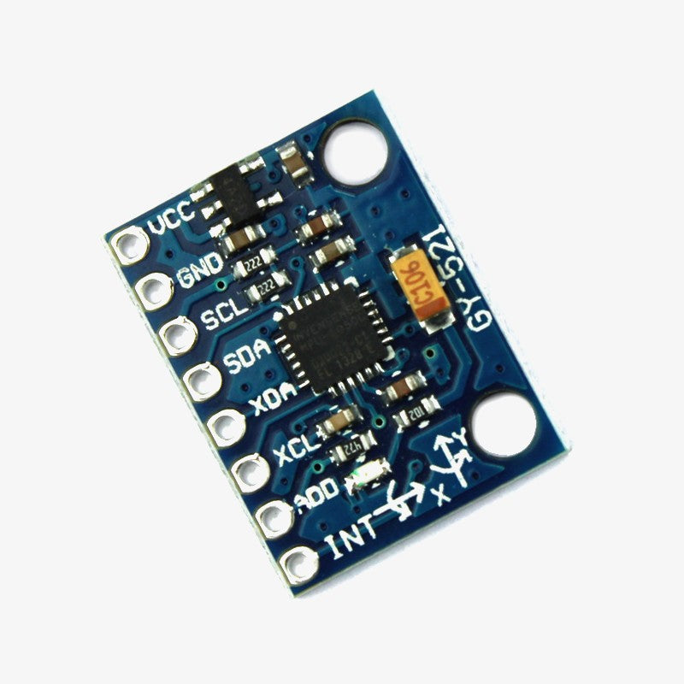
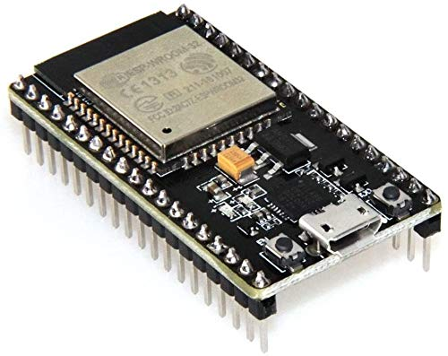
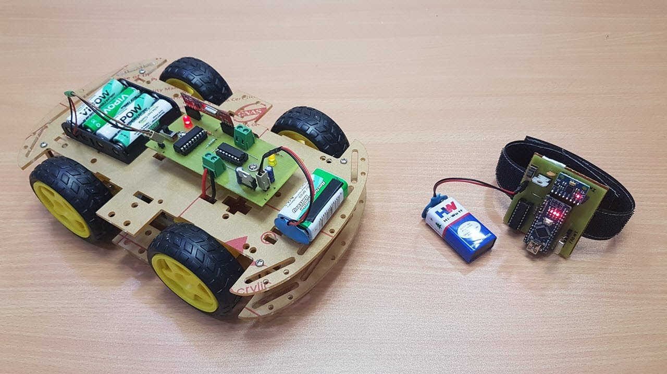
COMPONENTS USED
ESP 32 microcontroller
Car motors, wheels and board
Mpu6050 microcontroller
Arduino Uno
9V battery with clip
Jumper wires

Slide 5
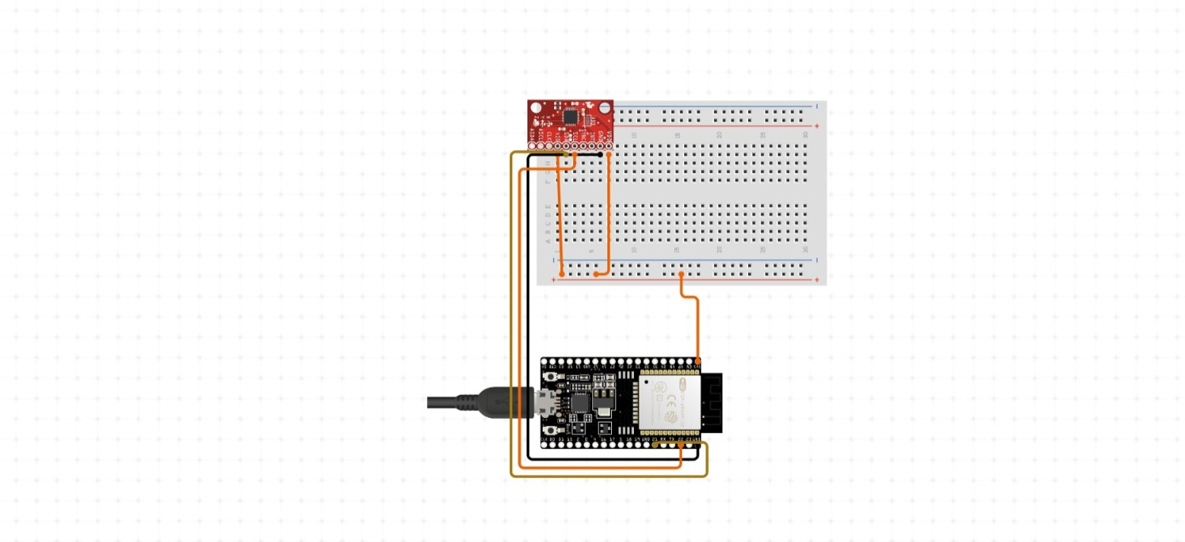
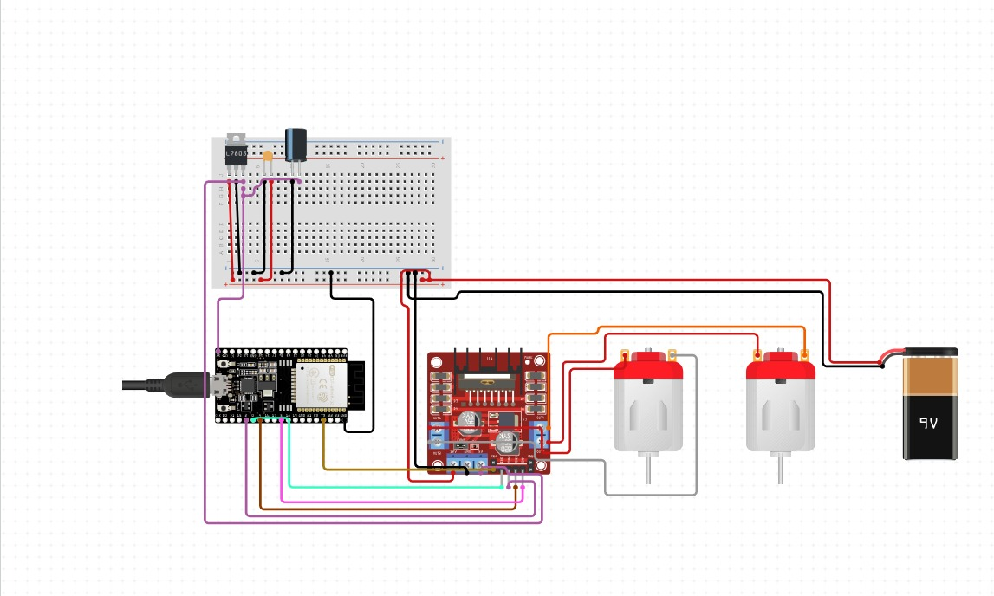
CIRCUIT DIAGRAM

Slide 6
RESULT
Hand Gesture Controlled Remote Car in IoT revolutionizes vehicle control by integrating gesture recognition technology with IoT infrastructure. This innovation allows users to control the car's movements effortlessly through intuitive hand gestures, eliminating the need for traditional physical controllers. It enhances user engagement, accessibility, and inclusivity, particularly benefiting individuals with physical disabilities who may find conventional controllers challenging to use. Beyond its user-centric advantages, this implementation serves as a showcase for technological advancements in IoT, sensor technologies, and gesture recognition algorithms. It also provides valuable educational opportunities in STEM fields, enabling students to learn about IoT, programming, and human-computer interaction in a hands-on manner. Additionally, it offers a platform for research and development in gesture recognition and IoT integration, driving innovation in these domains. Overall, Hand Gesture Controlled Remote Car in IoT represents a significant leap forward in interactive vehicle control, with far-reaching implications for entertainment, accessibility, and technological progress.

Slide 7
CONCLUSION
In conclusion, the Hand Gesture Controlled Remote Car in IoT is a groundbreaking innovation, merging gesture recognition with IoT technology. It simplifies vehicle control by allowing users to navigate the car effortlessly through intuitive hand movements. This advancement enhances accessibility, particularly for those with physical disabilities, and promotes a hands-free interaction experience. Beyond its practical benefits, it showcases advancements in IoT and gesture recognition algorithms, serving as a valuable educational tool and research platform. As we delve deeper into this technology, it promises to revolutionize how we interact with devices, blurring the lines between the physical and digital worlds. The Hand Gesture Controlled Remote Car exemplifies the potential of human-centered design in shaping the future of technology, offering a glimpse into a more intuitive and interconnected world.

Slide 8
FUTURE ENHANCEMENT
Advanced Gesture Recognition: Incorporate more sophisticated algorithms to accurately interpret a broader range of hand gestures.
Adaptive Machine Learning: Implement machine learning algorithms to allow the system to learn and adapt to users' gestures over time, enhancing customization.
Obstacle Detection: Integrate obstacle detection and avoidance sensors to enhance safety and autonomy, enabling the car to navigate its environment more effectively.
Energy Efficiency: Explore energy-efficient designs and renewable power sources to prolong battery life and reduce environmental impact.
Augmented Reality Integration: Explore integrating augmented reality features to enhance the immersive experience and provide additional functionalities

Slide 9


